Slide 1

Are KAPB Studies still relevant
in the Automotive Sector?
An imperative for a
comprehensive assessment tool
Dr Jill Von Der Marwitz (D Cur)
&
Dr Liana Steenkamp
(Research Associate)
HIV and AIDS Research Unit, Summerstrand South Campus

Slide 2

BRIEF OUTLINE
Introduction
Background
Problem statement
HIV&AIDS prevalence - update
Literature review
Theoretical framework
Research aim and objectives
Research Design and Methodology-limitation
Research Design and Methodology-results
Conclusion
Recommendations
References

Slide 3
INTRODUCTION
South Africa (SA) is struggling with a double burden of disease:
Persistent high HIV prevalence rate (UNAIDS, 2011)
Increasing rate of chronic diseases including:
  Hypertension.
  Diabetes.
  Epilepsy.
  Obesity (Stats SA, 2010).
According to the Technical Assistance Guidelines on HIV&AIDS report (2012:2), HIV&AIDS has a significant impact on South African workplaces, the epidemic primarily affects working age adults and this necessitated a relook at the health, safety and wellbeing of employees.

Slide 4
BACKGROUND
Supply Chain Development.
Supplier Development, Skills Development and Training.
To assist automotive supplier companies with the implementation of comprehensive HIV&AIDS WWPs and improve their global competiveness.
Include an economic impact assessment, Knowledge, Attitude, Behavior and Beliefs (KAPB) surveys and design of the most efficient HIV&AIDS WPP tailor made for each participating supplier.

Slide 5
BACKGROUND
KAPB surveys are ongoing in the AIDC workplace and are also being used as a monitoring tool that forms the baseline for future studies to determine the impact of all health interventions initiated by the specific company

Slide 6
PROBLEM STATEMENT
The HIV&AIDS epidemic continues to target the most productive workforce, namely those between 15-49 years of age (ILO, 2009):
Prevailing coexistence of chronic diseases has escalated at an alarming rate (Bradshaw and Levitt 2011).
Multi-sectoral responses.
Substantial investments and mobilisation of resources.
Selected companies in the sector have been invited to participate in this KAPB survey, with the main objective to identify challenges in the implementation of WWP in the automotive sector

Slide 7
HIV AND AIDS PREVALENCE UPDATE
Nationally, South Africa’s HIV infections fall to 5.4 Million (29/08/2011)

Slide 8
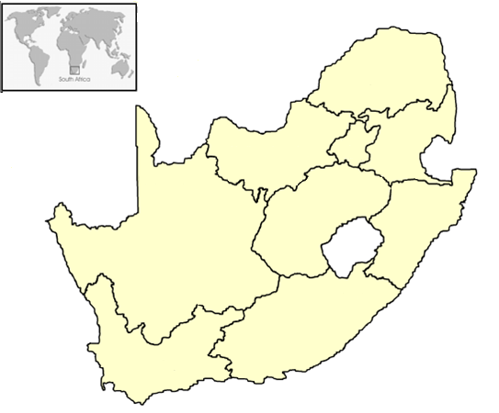
SA HIV PREVALENCE (%) ACCORDING TO PROVINCE: 2009/2010
Northern Cape
Western Cape
Eastern Cape
Kwazulu Natal
Free State
Northwest Cape
Gauteng
Mpumalanga
Northern Province
Northern Province
21.4/21.9
Northwest Province
Mpumalanga
Gauteng
29.8/30.4
34.7/35.1
30.0/29.6
Free State
30.1/30.6
Kwazulu Natal
Northern Cape
39.5/39.5
17.2/18.4
Eastern Cape
28.1/29.9
Western Cape
16.9/18.5

Slide 9
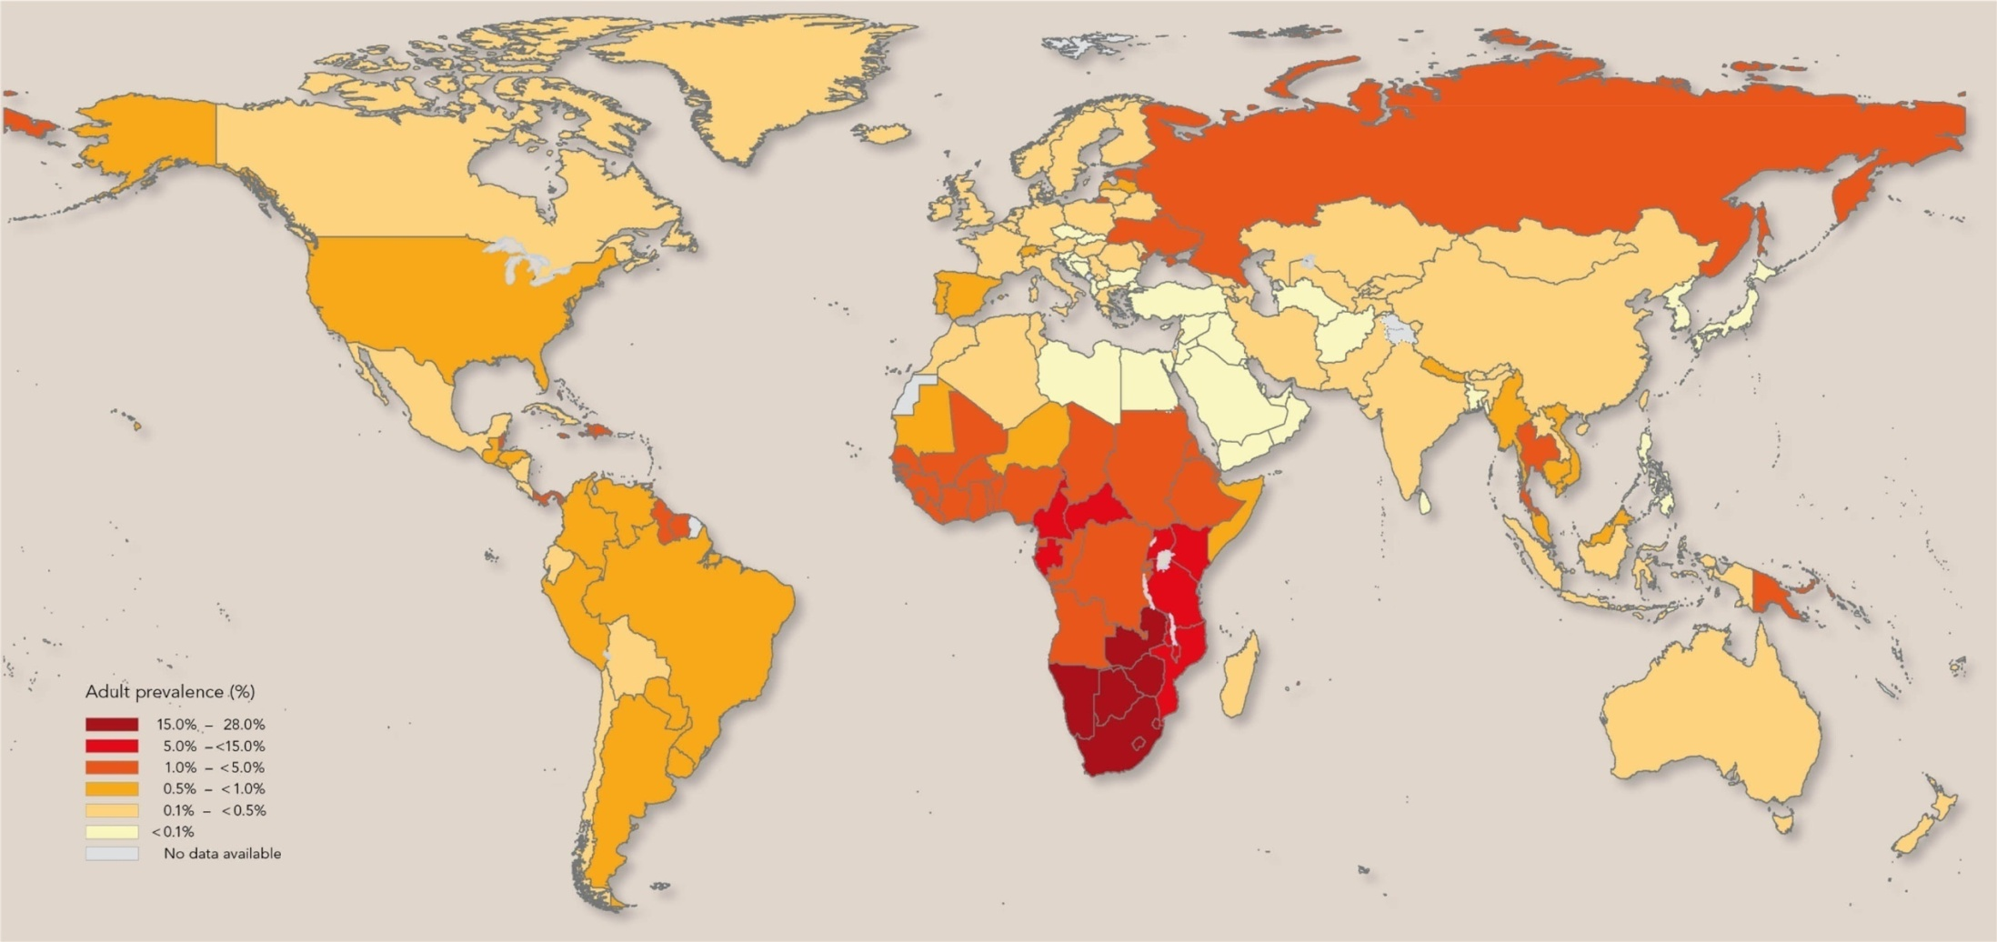
GLOBAL VIEW HIV/AIDS: 2009/2011
People living with HIV 2009: 33.3 (Million) 34 Million in 2011
New HIV infections 2009: 2.6 (Million) 2.5 in 2011
Deaths due to AIDS 2009: 1.8 (Million) 1.7 in 2011
http://unaids.org

Slide 10
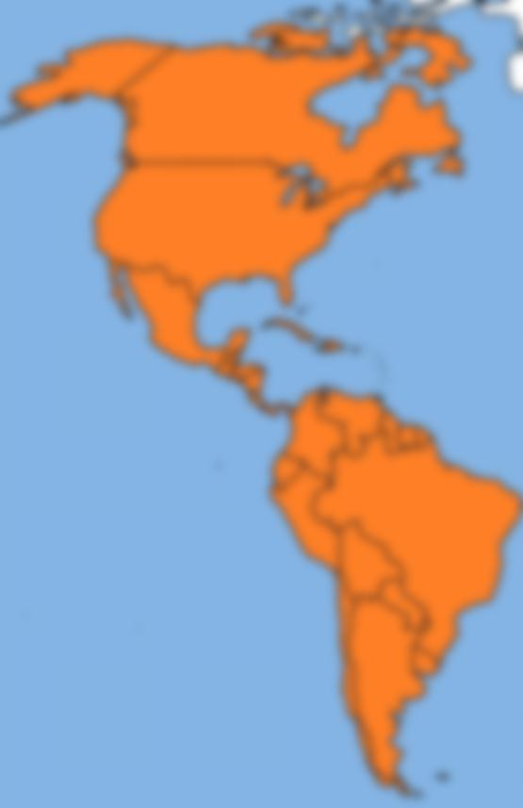
ESTIMATED NUMBER OF ADULTS AND CHILDREN NEWLY INFECTED WITH HIV DURING 2009/2011
North America
Caribbean
Latin America
2009
2011
179 000
147 000
unaids.org/en/media/unaids/contentassets/documents/epidemiology/2012/gr2012/20121120_UNAIDS_Global_Report_2012

Slide 11
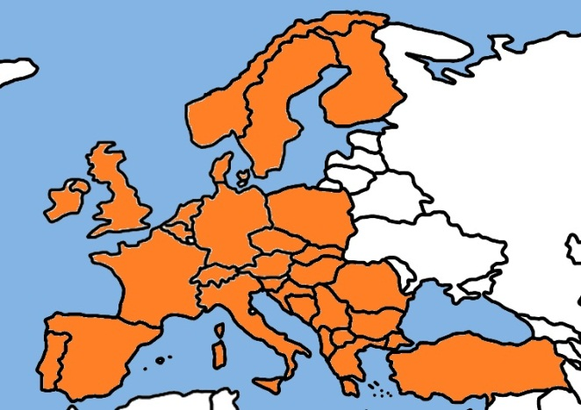
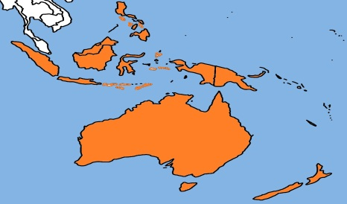
ESTIMATED NUMBER OF ADULTS AND CHILDREN NEWLY INFECTED WITH HIV DURING 2009/2011
Western & Central Europe
Oceania
2009
2011
35 500
32 900
unaids.org/en/media/unaids/contentassets/documents/epidemiology/2012/gr2012/20121120_UNAIDS_Global_Report_2012

Slide 12
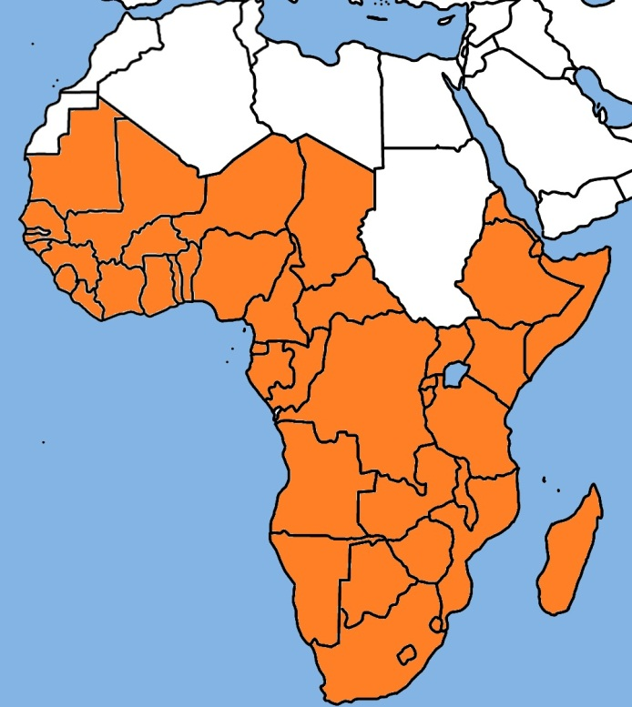
ESTIMATED NUMBER OF ADULTS AND CHILDREN NEWLY INFECTED WITH HIV DURING 2009/2011
Sub Saharan Africa
2009
2011
1.8 million
1.8 million
unaids.org/en/media/unaids/contentassets/documents/epidemiology/2012/gr2012/20121120_UNAIDS_Global_Report_2012

Slide 13
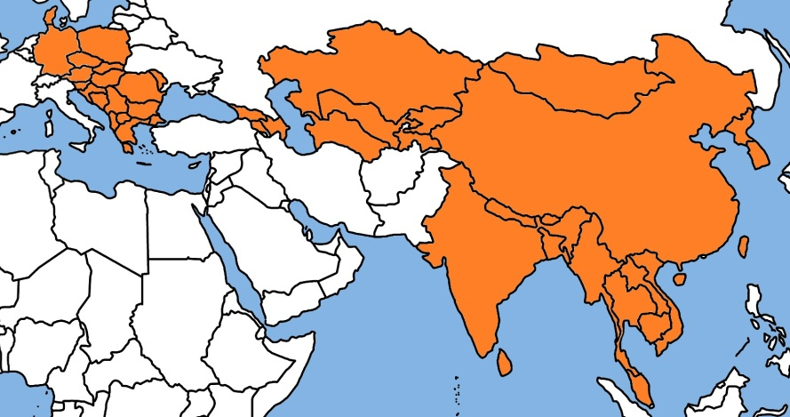
ESTIMATED NUMBER OF ADULTS AND CHILDREN NEWLY INFECTED WITH HIV DURING 2009/2011
Eastern Europe & Central Asia
South & East Asia
2009
2011
482 000
509 000
unaids.org/en/media/unaids/contentassets/documents/epidemiology/2012/gr2012/20121120_UNAIDS_Global_Report_2012

Slide 14
ESTIMATED ADULT AND CHILD DEATHS DUE TO AIDS DURING 2009/2011
North America
Caribbean
Latin America
2009
2011
96 000
85 000
unaids.org/en/media/unaids/contentassets/documents/epidemiology/2012/gr2012/20121120_UNAIDS_Global_Report_2012

Slide 15
ESTIMATED ADULT AND CHILD DEATHS DUE TO AIDS DURING 2009/2011
Western & Central Europe
Oceania
2009
2011
9 900
8 300
unaids.org/en/media/unaids/contentassets/documents/epidemiology/2012/gr2012/20121120_UNAIDS_Global_Report_2012

Slide 16
ESTIMATED ADULT AND CHILD DEATHS DUE TO AIDS DURING 2009/2011
Sub Saharan Africa
2009
2011
1.3 million
1.2 million
unaids.org/en/media/unaids/contentassets/documents/epidemiology/2012/gr2012/20121120_UNAIDS_Global_Report_2012

Slide 17
ESTIMATED ADULT AND CHILD DEATHS DUE TO AIDS DURING 2009/2011
Eastern Europe & Central Asia
South & East Asia
2009
2011
372 000
401 000
unaids.org/en/media/unaids/contentassets/documents/epidemiology/2012/gr2012/20121120_UNAIDS_Global_Report_2012

Slide 18
CHRONIC DISEASES OF LIFESTYLE (CDL) - STATISTICS

Slide 19
CHRONIC DISEASES OF LIFESTYLE (CDL) - STATISTICS

Slide 20
LITERATURE REVIEW
HIV risk behaviour and the workplace
Integration of care for people on ART and with non-communicable diseases is important and should require thought and planning, especially since it may impact on the workforce as well
Chronic Diseases of Lifestyle (The 3 most contributing factors)
Cardiovascular disease
Diabetes
Hypertension

Slide 21
LITERATURE REVIEW
The business Sector and Wellness
Employee Assistance Programmes (EAP)
The South African Business Coalition (SABCOHA) on HIV&AIDS & AIDS accountability International (AAI)
No monitoring and evaluation system in place that can track the actual costing of the epidemic

Slide 22
RESEARCH AIM AND OBJECTIVES
Aim of Research:
To collect baseline data regarding the knowledge, attitudes, behaviour and practices of the employees in the automotive industry in relation to HIV&AIDS.

Slide 23
RESEARCH AIM AND OBJECTIVES
Objective of Research is to determine:
Levels of employee knowledge about the transmission, symptoms, prevention and treatment of HIV&AIDS and TB.
Employees’ sexual attitudes and practices.
The prevalence of stigma.

Slide 24
RESEARCH DESIGN AND METHODOLOGY
Research Design
Utilization of a self-administered questionnaire as a quantitative survey.
Data collection from 7 automotive companies (n = 733) implementing HIV&AIDS Workplace Programmes with the Support of the Automotive Industry Development Center (AIDC)

Slide 25
RESEARCH DESIGN AND METHODOLOGY
Participants
All employees employed at the respective companies at the time of the survey.

Slide 26
RESEARCH DESIGN AND METHODOLOGY
Measuring intruments
Closed-type questions with the majority requiring answers of “yes”, “no” or “not sure”.
Questions in English.
Questionnaire divided in 7 sections:
  Biographical Data
  Healthy Lifestyle/behaviour
  Knowledge and attitudes
  Knowledge of HIV&AIDS Workplace Programmes and Policies
  Access to HIV Counselling and Testing Services
  Care and Support
  Stigma and Disclosure

Slide 27
RESEARCH DESIGN AND METHODOLOGY
Data collection procedure
All employees briefed by Companies’ management.
Letter sent to all employees explaining purpose of the study, voluntary participation, anonymity and confidentiality.
Obligation to hand-in questionnaires within a weeks’ time.
Data collection of the 7 companies took place in 2012 – 2013.

Slide 28
RESEARCH DESIGN AND METHODOLOGY
Ethical considerations
Ethical approval obtained from the Research Ethics Committee (Human) of the Nelson Mandela Metropolitan University (NMMU).
No personal information recorded on the questionnaire
Participants had the rights not to participate.

Slide 29
RESEARCH DESIGN AND METHODOLOGY
Statistical analyses
Data analysed using MS Excel and Statistica.
Frequencies and percentages used to present categorical data.
Subgroups compared using Pearson chi-square tests.

Slide 30
FINDINGS
Biographical data
Mean age of 36.4 years for the sample.
Standard deviation of 9.2 (only 670 reported their age), with 68% (n=484) being female.

Slide 31
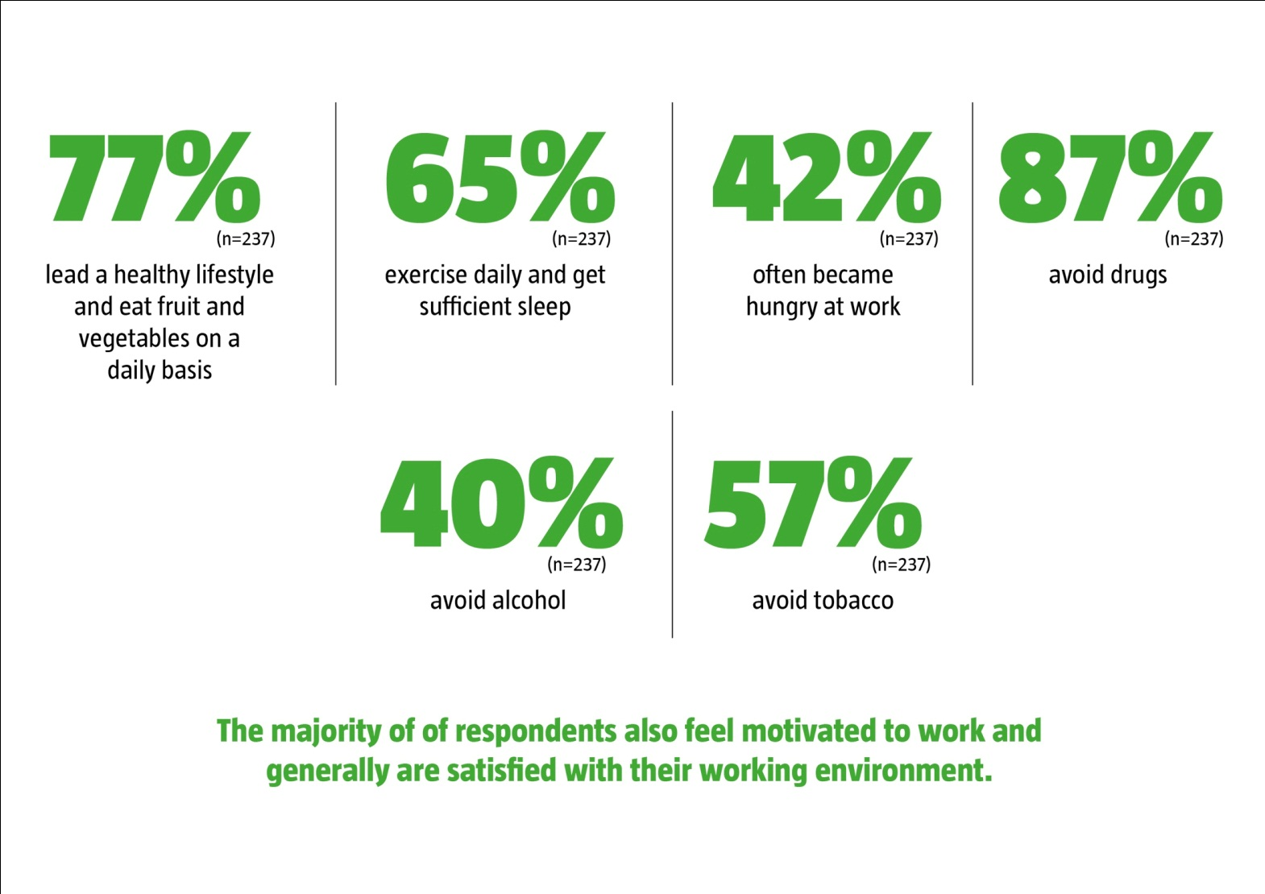
FINDINGS
Healthy Lifestyle/Behaviour

Slide 32
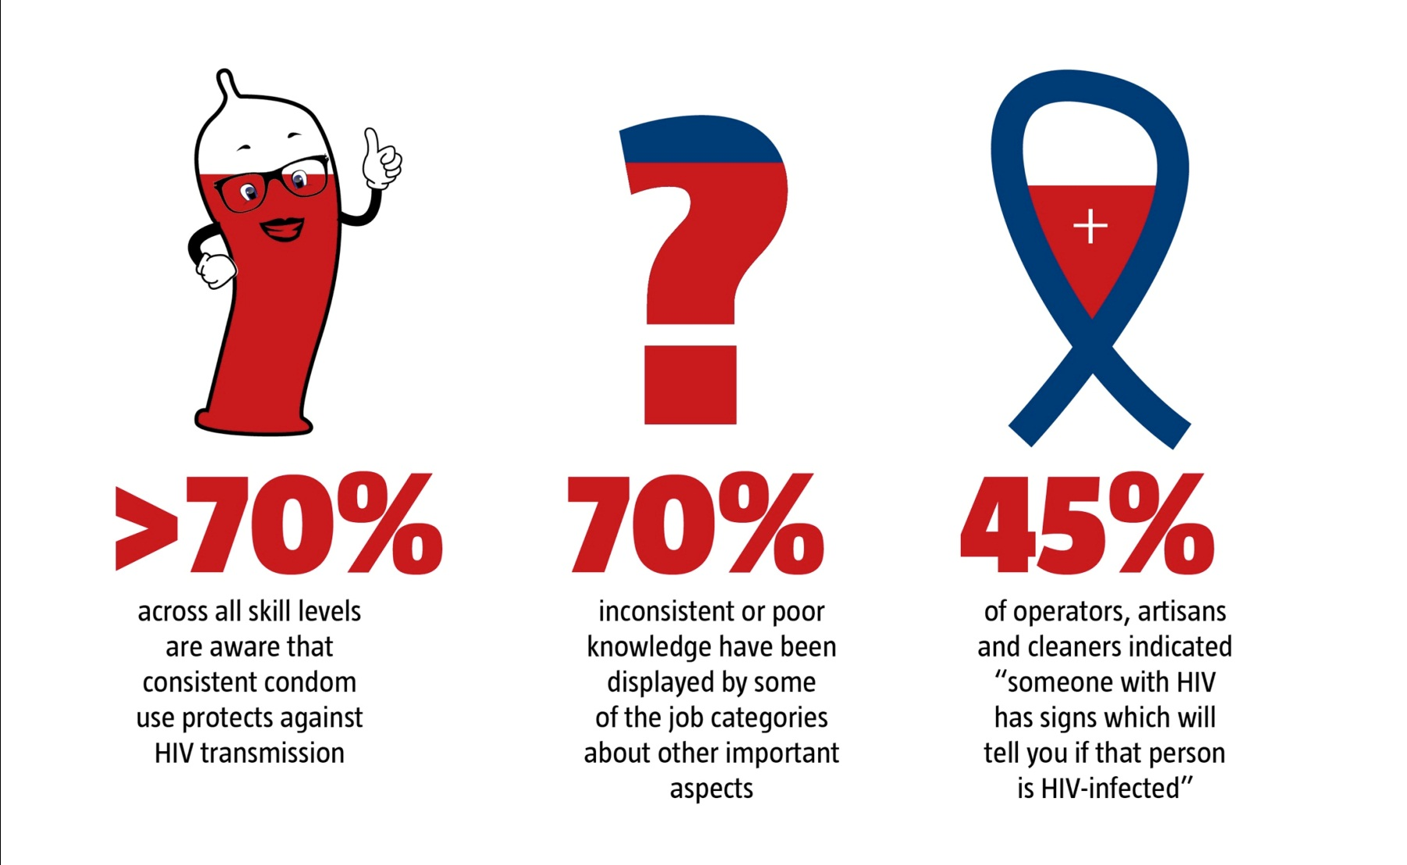
FINDINGS
Knowledge of HIV&AIDS

Slide 33
FINDINGS

Slide 34
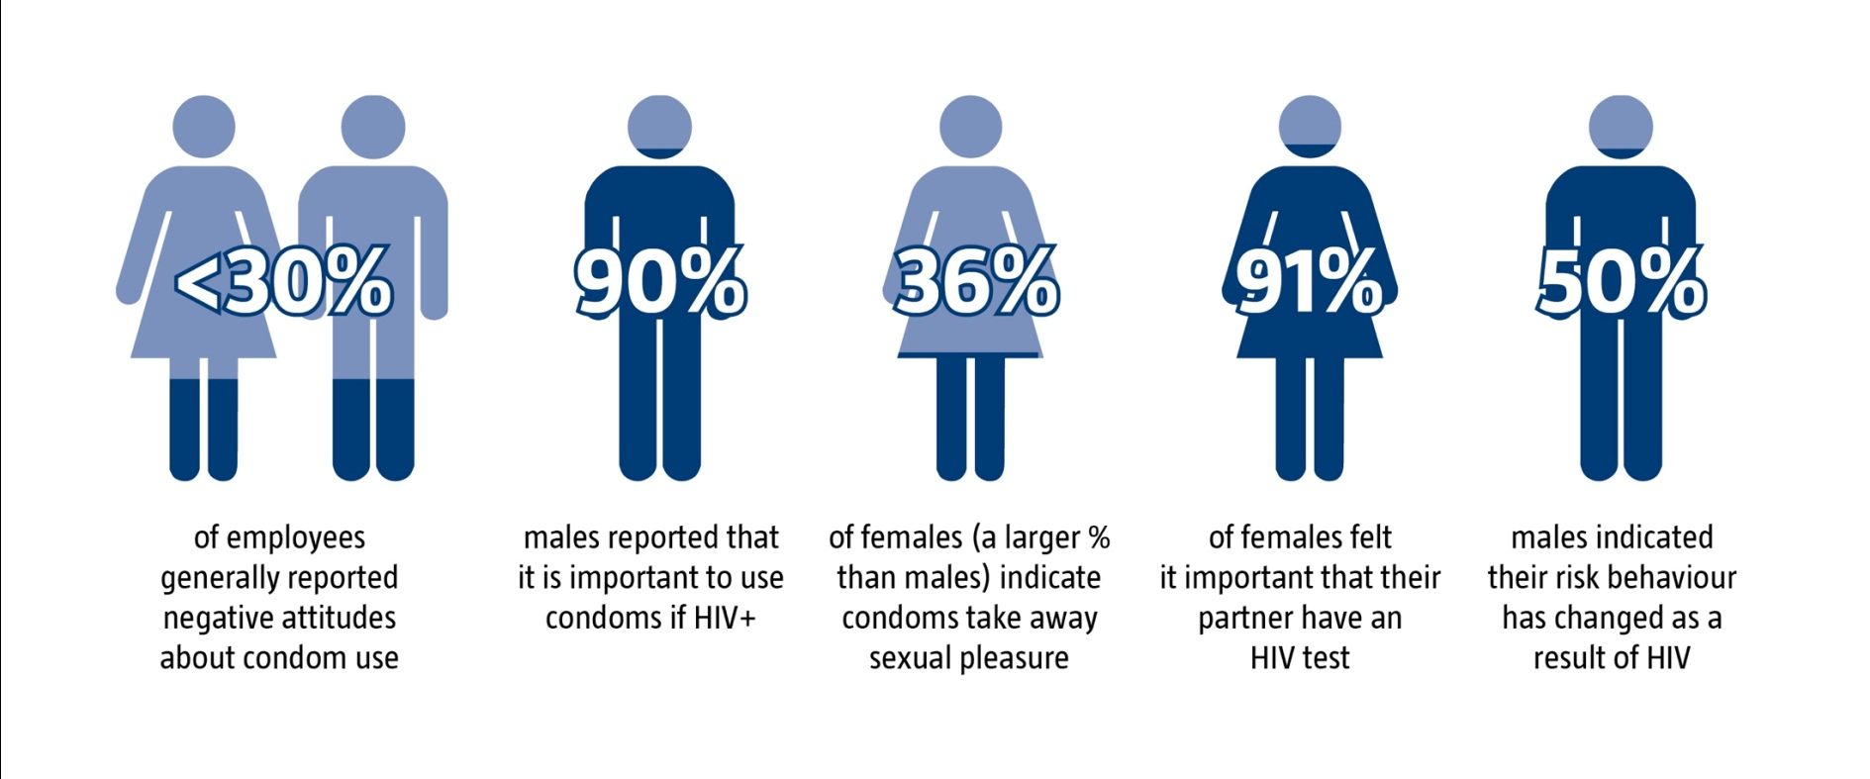
FINDINGS
Attitude and gender

Slide 35
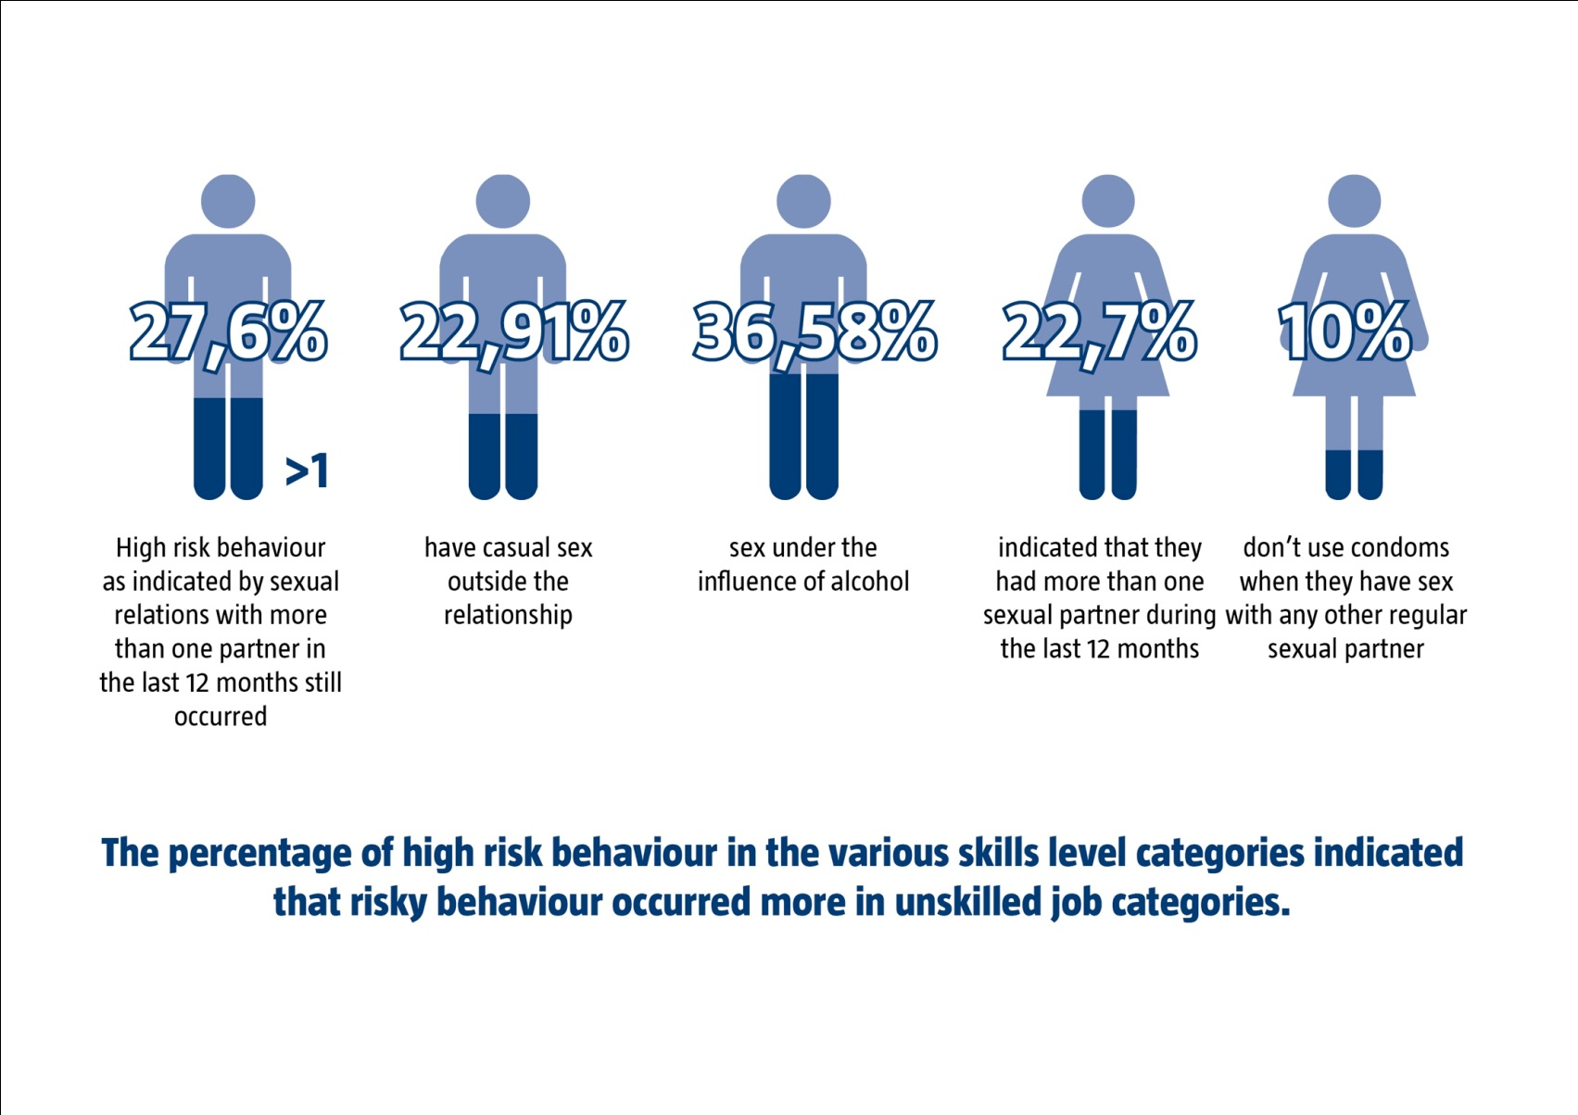
FINDINGS
Sexual risk behaviour

Slide 36
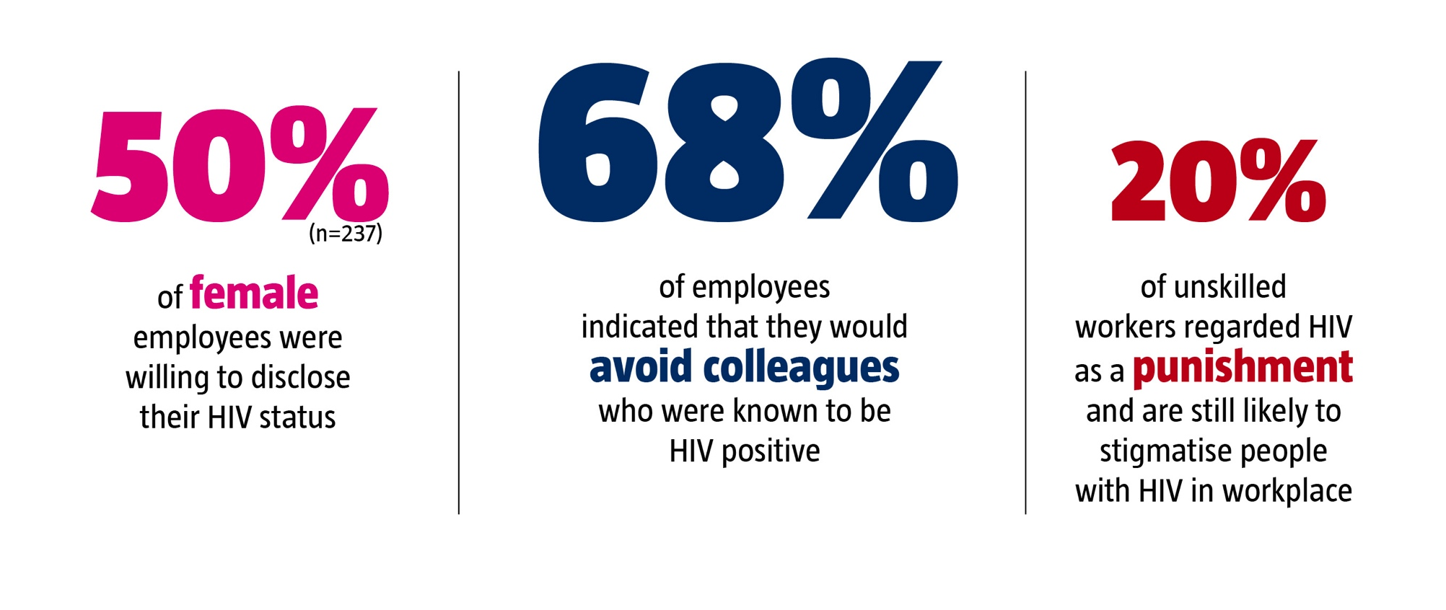
RESEARCH DESIGN AND METHODOLOGY
Disclosure and stigma

Slide 37
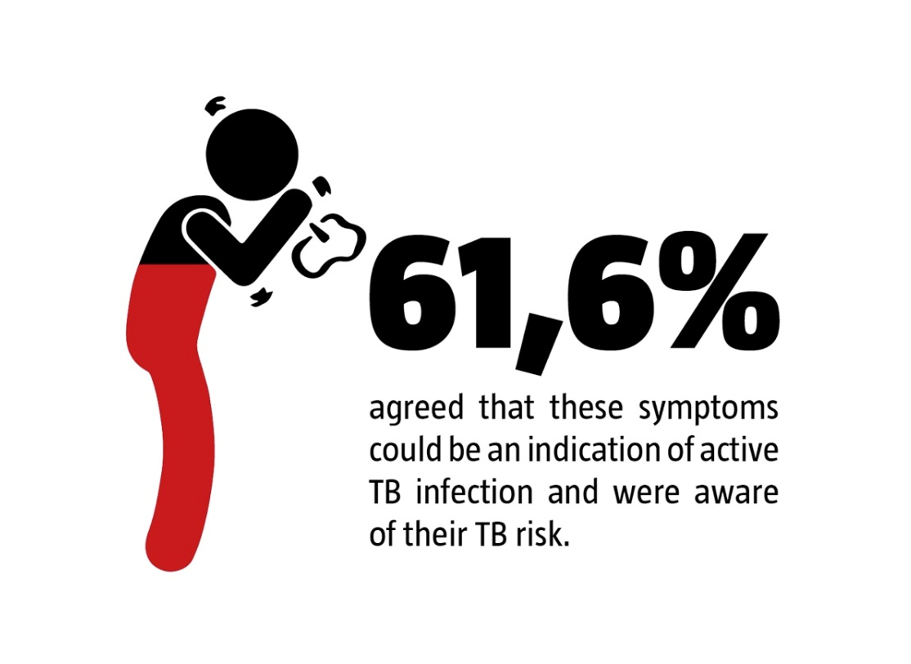
RESEARCH DESIGN AND METHODOLOGY
Tuberculosis
Participants were asked to indicate some of the visible critical markers of active TB, namely having a cough for longer than two weeks, or a persistent cough with blood stained sputum. Responses indicated that (61.6%) agreed that these symptoms could be an indication of active TB infection and were aware of their TB risk.

Slide 38
CONCLUSION
Challenges in the implementation of WWP
More pronounced misconceptions in unskilled and semi-skilled categories as well as women and youth.
Messages and interventions should focus on these specific groups by adapting vehicles to deliver these messages, language or address attitudes.
dedicated budget should be set aside for such a programme.
Management should get involved, especially to de-stigmatized HIV.
The challenge for most companies is to establish comprehensive wellness programmes to mitigate the direct and indirect losses which may accrue as a result of absenteeism.

Slide 39
CONCLUSION
Is KAPBs studies still relevant?
The relevancy is to provide baseline data to inform workplace programmes.
Hence, it is envisaged that the KAPBs studies be adapted to include baseline data on the escalating chronic diseases.
However, the relevancy of the existing KAPB study is questionable as it does not capture the rich data which the employee could provide.

Slide 40
RECOMMENDATIONS
Limitations
Bias may have occurred as majority of employees are Xhosa speaking; the questionnaire was only available in English.
Many employees completed the questionnaire in their own time and may have misinterpreted some questions.

Slide 41
REFERENCES
Addley K. Creating healthy workplaces in Northern Ireland: evaluation of a lifestyle and physical assessment programme. Occupational Medicine, 51 (7): 430-449. 2001
American Society for Training and Development Staff. 2009. Businesses Look to Wellness Programs to Improve Productivity and Lower Absenteeism
Bradshaw D, Steyn K, editors. Poverty and chronic disease in South Africa. Technical report. Cape Town: South African Medical Research Council; 2001.
Campbell K.M. DeVellis B., Benedict S. Tailoring and targeting a worksite health promotion program to address multiple health behaviours among blue-collar women. American Journal of Health Promotion, 14, (5): 306-313. 2000
Chimbetete, M. and Gwandure, C. 2011. Impact of a Workplace-based HIV and AIDS risk reduction training intervention. Journal of Human Ecology, 35(1), 11-19
Colvin M, Connolly C, Madurai L. The epidemiology of HIV in South African workplaces. AIDS. 2007 Jul [cited 2013 Jun 27]; 21 Suppl 3:S13-9. Available from:http://www.ncbi.nlm.nih.gov/pubmed/17666957

Slide 42
REFERENCES
Daniels S.R., Pratt C.A., Hayman R.N. Reduction of Risk for Cardiovascular Disease in Children and Adolescents. University of Colorado School of Medicine, Aurora. 2011 Available from: http://circ.ahajournals.org/content/124/15/1673.full
Department of Health South Africa. National HIV and Syphilis Antenatal Prevalence Survey. South Africa. Pretoria. 2011
Department of Health. Nelson Mandela Bay District Health Plan. Eastern Cape. 2012
Department of Labour. Technical Assistance Guidelines on HIV and AIDS and the world of work. Pretoria. 2012. Available from http://www.ilo.org/wcmsp5/groups/public/---ed_protect/---protrav/---ilo_aids/documents/legaldocument/wcms_125641.pdf
Emberson J.R., Wincup P.H., Morris, R.W., Shaper, A.G. Lifestyle and cardiovascular disease in middle aged British men: the effect of adjusting for person within variation. European Heart Journal. 26: 1774-1782. 2005
Galvin D.M. Workplace managed care: collaboration for substance abuse prevention. The Journal of Behavioural Health Sciences and Research, 27: 125-130 May 2005.

Slide 43
REFERENCES
Goetzel, R.Z. and Ozminkowski, R.J. The Health and Cost Benefits of Work Site Health-Promotion Programs. Department of Health and Productivity Research, Washington D.C. 2008
Harrison D. An Overview of Health and Health care in South Africa 1994-2010: Priorities, Progress and Prospects for New Gains. Muldersdrift. 2009
Higher Education HIV/AIDS Programme. HIV Prevalence and Related Factors-Higher Education Sector Study 2008-2009, Pretoria. 2010
IDS Diabetes Atlas. The Global Burden. Brussel, Belgium. 2011 Available from : http://www.idf.org/diabetesatlas/5e/the-global-burden
International Labour Conference. 98th Session. Geneva; Switzerland. 2009 Also available: http://www.ilo.org/public/portugue/region/eurpro/lisbon/pdf/vihsida_en.pdf
Kelland K. Chronic Disease to Cost $47 trillion (Reuter) London. 18 September 2011 Available from : http://www.reuters.com/article/2011/09/18/us-disease-chronic-costs-idUSTRE78H2IY20110918

Slide 44
REFERENCES
Levitt NS, Steyn K, Dave J, Bradshaw D. Chronic non-communicable diseases and HIV-AIDS on a collision course: relevance for Health care delivery, particularly in low-resource settings—insights from South Africa. Am J Clin Nutr. 2011 [cited 2013 June 27];94(suppl):1690S–6S. Available from: http://ajcn.nutrition.org/content/94/6/1690S.full.pdf+html
Mahajan, A.P., Colvin, J.B., and Ettl, D. 2007. An Overview of HIV/AIDS Workplace Policies and Programmes in Southern Africa. AIDS, Vol. 21, No. 3, pp S31-S39
Makris A., Seferou M., Papadopoulos D.P. Resistant Hypertension Workup and Approach to Treatment. International Journal of Hypertension: 26 December 2010
National Heart, Lung and Blood Institute, 2012. Reducing Chronic Diseases Must Be a Global Priority . United States of America Available from: http://www.nhlbi.nih.gov/about/globalhealth/
Ngugi AK, Bottomley C, Kleinschmidt I, Wagner RG, Kakooza-Mwesige A, Ae-Ngibise K, et. al. Prevalence of active convulsive epilepsy in Sub-Saharan Africa and associated risk factors: cross-sectional and case-control studies. Lancet Neurol. 2013 Mar [cited 2013 June 27];12(3):253-63. doi: 10.1016/S1474-4422(13)70003-6. Available from: http://www.ncbi.nlm.nih.gov/pubmed/23375964

Slide 45
REFERENCES
Peltzer, K., Mzolo, T., and Tabane, C. 2010. Sexual Behaviour, HIV Status and HIV Risk among older South Africans. Human Sciences Research Council, Pretoria.
Rothermel S., Slavit W., Phillip K. An Employer’s Guide to Employee Assistance Programs. Centre for Prevention and Health Services. December 2008 Available from: http://www.businessgrouphealth.org/pub/f31372a2-2354-d714-51e4-ae4127ced552
Rukambe, Z., 2010. Employees’ Knowledge, Attitudes and Practices around HIV/AIDS at the Rosh Pinah Zinc Mine, Namibia. Master Thesis. Department of Social Work, Faculty of Humanities at the University of the Witwatersrand, Johannesburg.
Sandfort TGM, Nel J, Rich E, Reddy V, Yi H. HIV testing and self-reported HIV status in South African men who have sex with men: results from a community-based survey. Sex Trans Infect. 2008; 84:425–429. doi:10.1136/sti.2008.031500
Sprague L., Simon S., Sprague C. Employment discrimination and HIV stigma: survey results from civil society organisations and people living with HIV in Africa. NIBC pty ltd and Routledge, Taylor and Francis Group. 2011

Slide 46
REFERENCES
Statistics South Africa. Mid-year population estimates. Pretoria 2011
Technical Assistance Guidelines on HIV&AIDS report (2012:2),
The South African Business Coalition on HIV/AIDS. Helping Business to tacle AIDS http://www.southafrica.info/business/economy/development/sabcoha.htm#.UdMBcqxIN3o
The South African Medical Research Council. ‘Building a Healthy Nation Through Research. Annual Report March 2012
UNAIDS. World Aids Day Report: Joint United Nations Programme on HIV/AIDS. 2011
Van Olmen J, Schellevis F, Van Damme W, Kegels G, Rasschaert F. Review Article Management of Chronic Diseases in Sub-Saharan Africa: Cross-Fertilisation between HIV/AIDS and Diabetes Care. J Trop Med. 2012; (2012): 10 pages. doi:10.1155/2012/. Available from: http://www.hindawi.com/journals/jtm/2012/349312/
Weihs, M., Venter, D., Guillot D., Holistic Health Survey Report. 2011

Slide 47
REFERENCES
World Economic Forum, Harvard School of Public Health. The Global Economic Burden of Non-Communicable Diseases, Geneva. 2011 Available from : http://www3.weforum.org/docs/WEF_Harvard_HE_GlobalEconomicBurdenNonCommunicableDiseases_2011.pdf
World Health Organisation. Preventing chronic diseases: a vital investment, WHO global report, Switzerland, WHO. 182pp: 2005
World Health Organisation. Ten Facts on HIV/AIDS. Nov 2012
Zwicker V., Alison S., Alfonzo C. Theory of Reasoned Action, Theory of Planned Behaviour, and Integrated Behavioural Model. Health Promotion Strategies. Jan 2011

Slide 48
THANK YOU

